Slide 1
( near periphery of cell )
Nucleus
Skeletal Muscle Fiber
Striations

Slide 2
Nucleus
( central )
Cardiac Muscle Cell
( special junctions between cells )
Intercalcated Disks
Striations

Slide 3
Nucleus
Smooth Muscle Cell

Slide 4
Muscular Fascia
( surrounds individual muscles and groups of muscles )
Epimysium
( surrounds muscles )
Artery
Vein
Perimysium
( surrounds fasciculi )
Nerve
Endomysium
( surrounds muscle fibers )
Muscle Fiber
Artery
Nerve
Vein
Fasciculus
Axon of Motor Neuron
Neuromuscular Junction

Slide 5
Muscle Fibers
Endomysium
Nuclei
Capillary
Sarcoplasmic Reticulum
Sarcolemma
Transverse Tubule
Mitochondrion
Myofibrils
Striations

Slide 6
Actin Myofilament
Myofibril
Myosin Myofilament
Sarcolemma
Z Disk
Z Disk
Actin Myofilament
Myosin Myofilament
Cross-Bridge
M Line
Sarcomere

Slide 7
Myosin Molecule
F Actin Strands
Troponin
Attachment Site
Tropomyosin
Actin Myofilament
(thin)
Myosin Myofilament
Rod
Heads
Tropomyosin
Coiled-Portion
Light Chains
Troponin
G Actin Molecules
Heavy Chains
Hinge Region

Slide 8
Ca
Actin Myofilament
G Actin Molecule
Myosin Myofilament
Ca
Active Site
Cross-Bridge

Slide 9
Sarcomere
Myofibrils
Mitochondria
A Band
I Band
H Zone
Z Disk
Z Disk
M Line

Slide 10
A Band
I Band
Sarcoplasmic Reticulum
Sarcolemma
Terminal Cisterna
Triad
Transverse Tubule
Terminal Cisterna
Capillary
Myofibril
Mitochondrion

Slide 11
Dendrites
Cell Body
Schwann Cell
Axon
Node of Ranvier
Presynaptic Terminal

Slide 12
Axon Branch
Presynaptic Terminal
Synaptic Vesicles
Neuromuscular Junction
Presynaptic Terminal
Sarcolemma
Capillary
Muscle Fiber
Sarcoplasm
Sarcoplasmic Reticulum
Myofibrils
Mitochondrion
Synaptic Cleft
Postsynaptic Membrane
( sarcolemma )

Slide 13
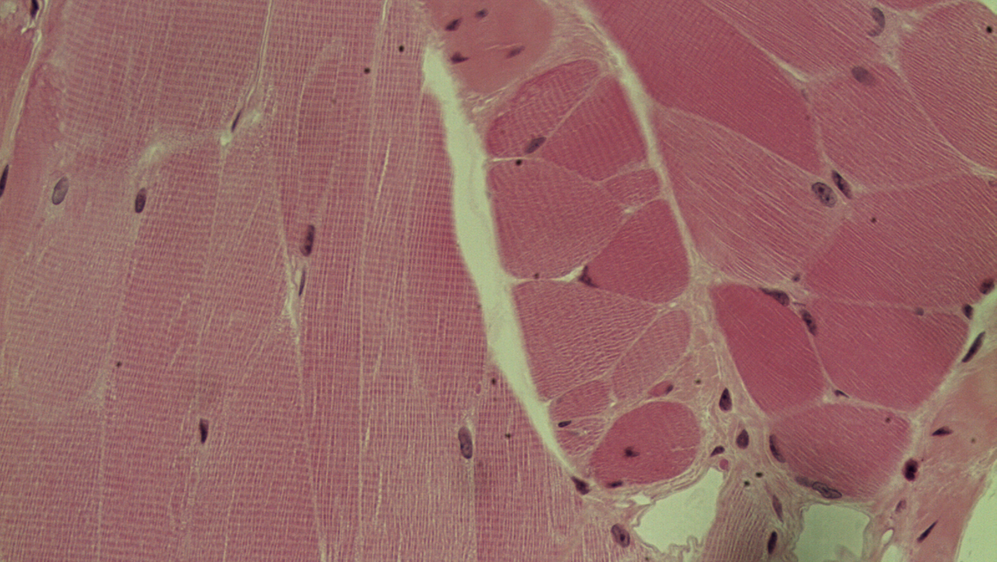
Slide M-1 = Skeletal Muscle
Cross Section
Longitudinal Section

Slide 14
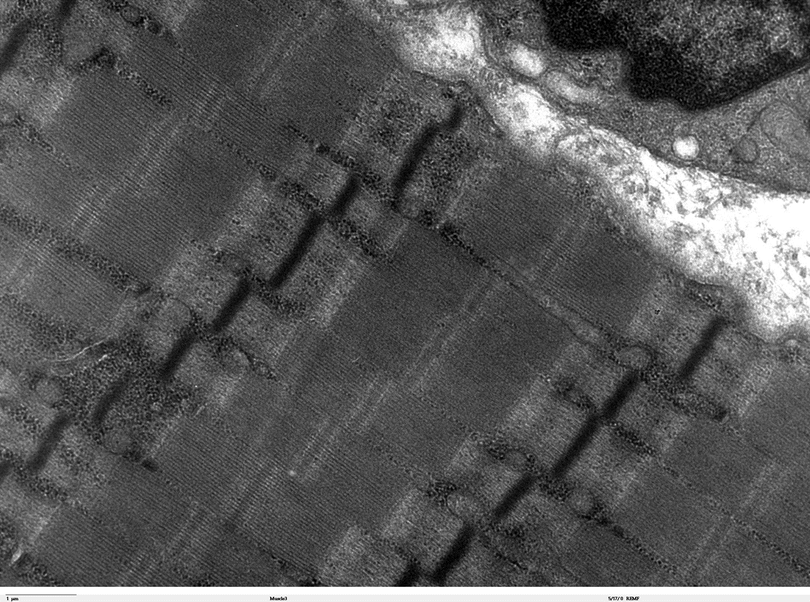
Slide M-2 = Skeletal Muscle Tissue
Sarcomere

Slide 15
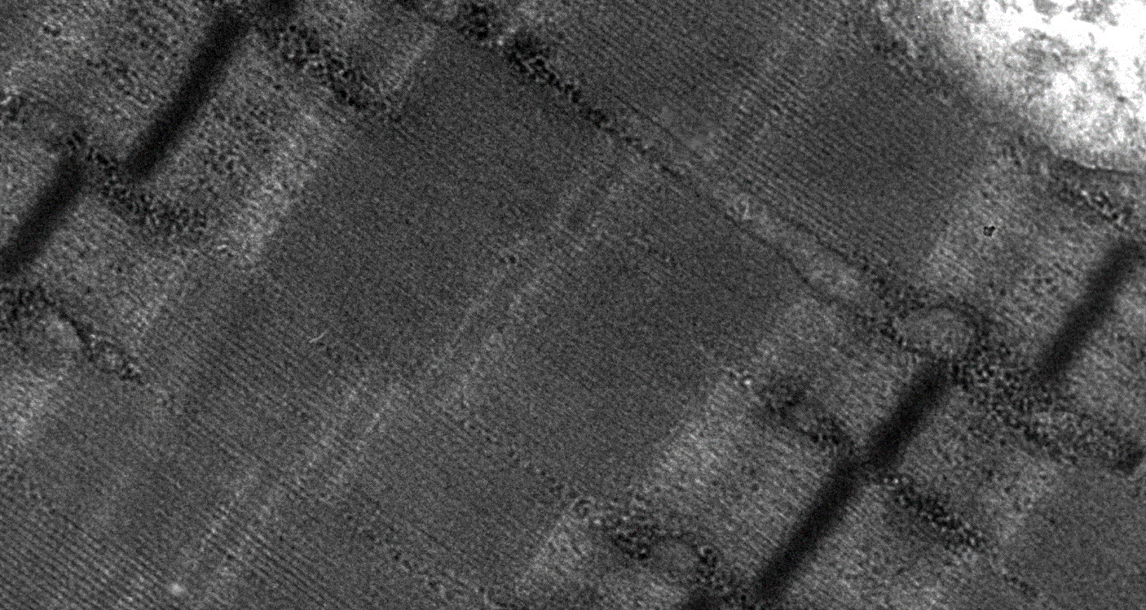
Slide M-3 = Skeletal Muscle Tissue
Z Disk
A Band
M Line
I Band
H Zone
Z Disk

Slide 16
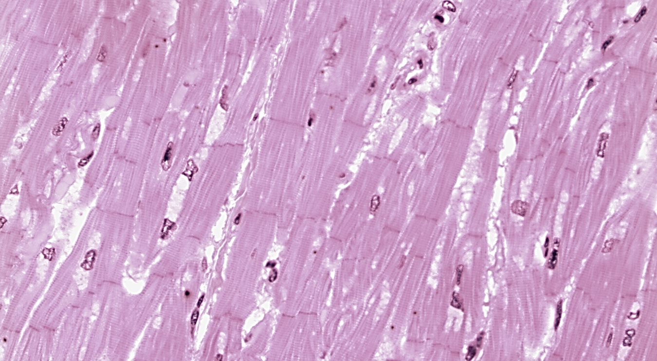
Slide M-4 = Cardiac Muscle Tissue
Intercalated Disk
Nucleus

Slide 17
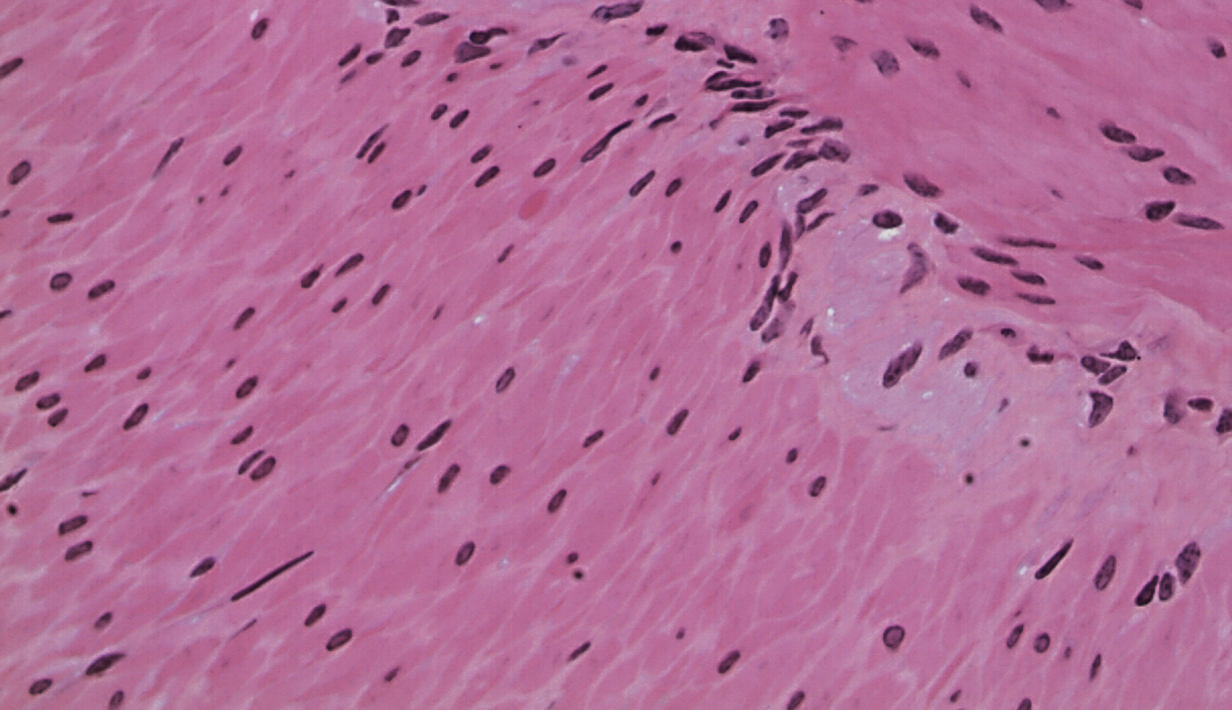
Slide M-5 = Smooth Muscle Tissue
Nucleus

